Slide 1
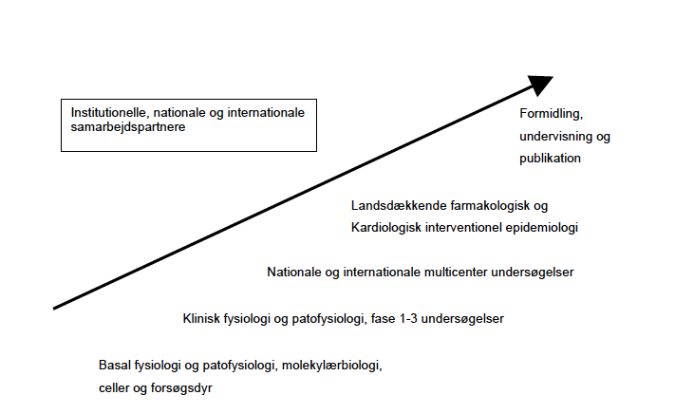
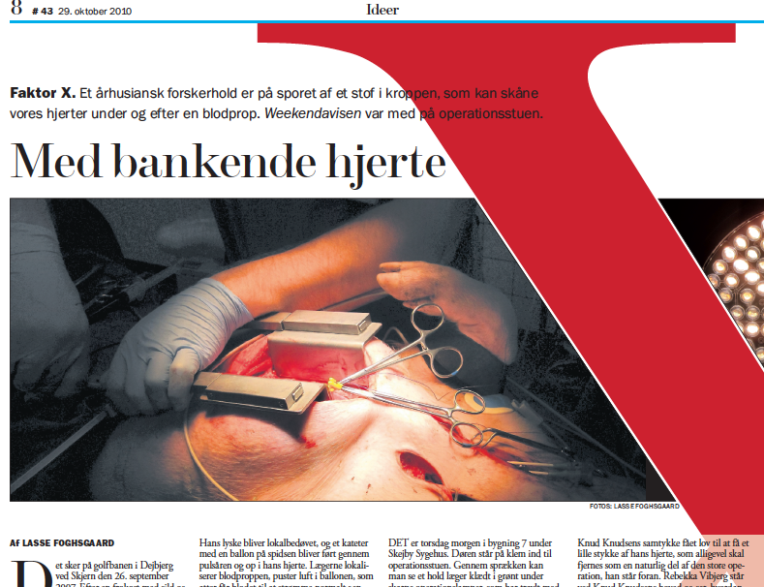
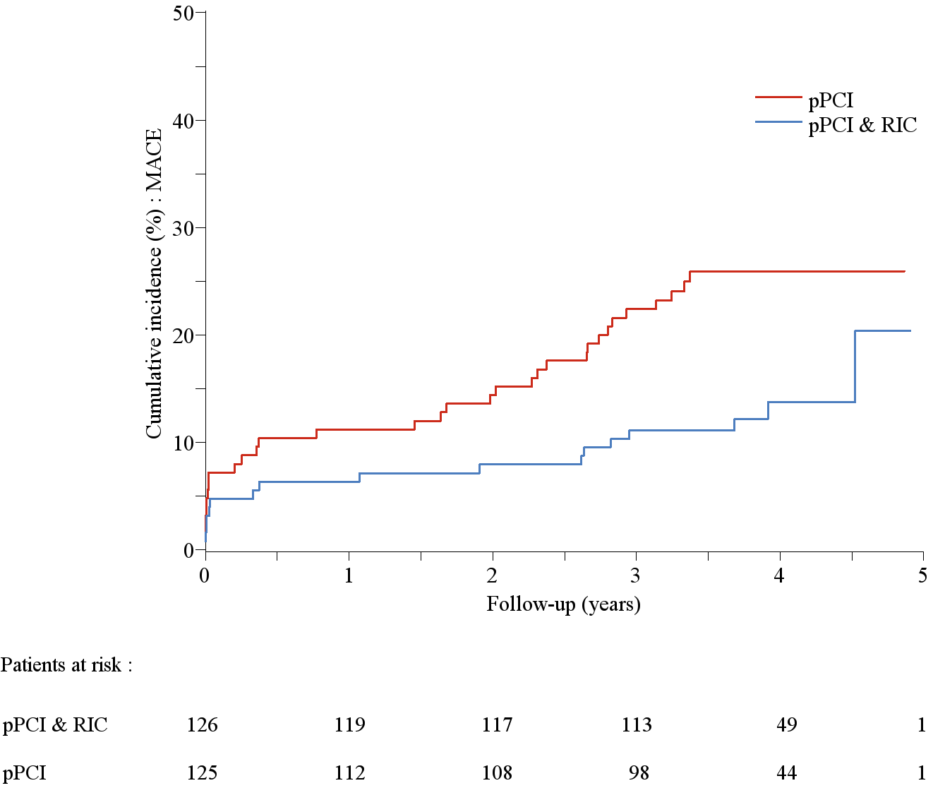
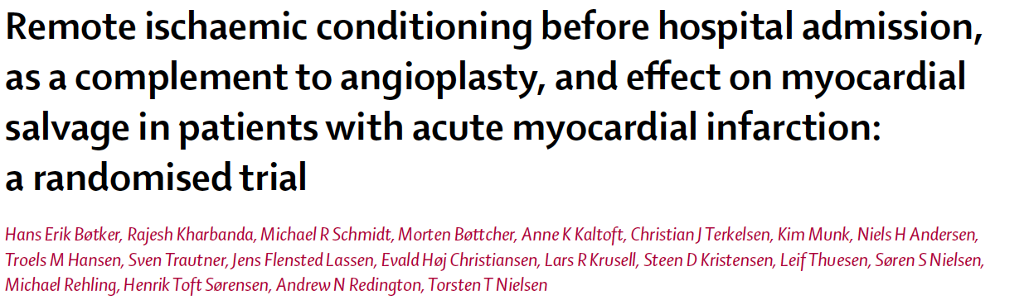

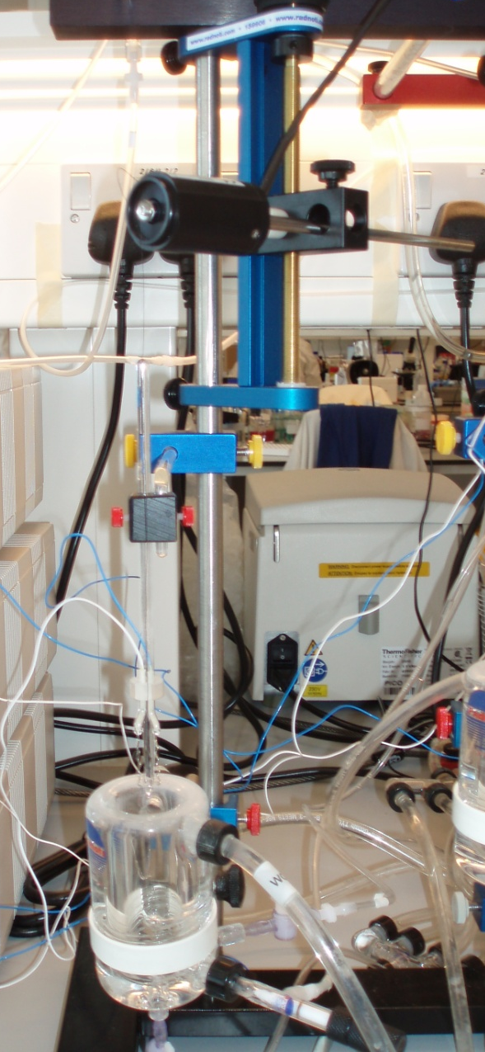
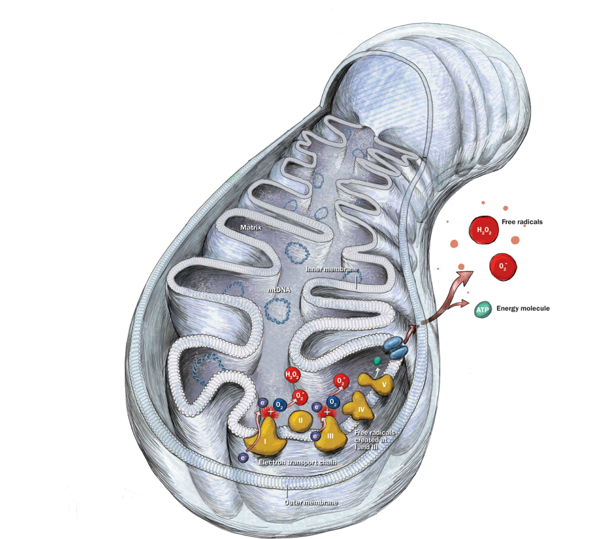
Translationelle muligheder
1. MR: acute phase

Slide 2


Moderne behandling af blodprop i hjertet og muligheder for fortsat forbedring
Hans Erik Bøtker MD, PhD, FACC, FESC
Aarhus University Hospital Skejby
Denmark

Slide 3
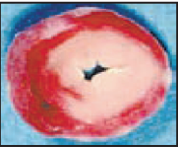

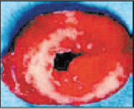
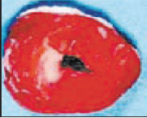
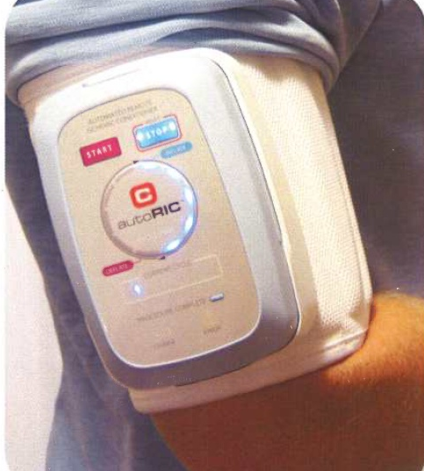
Behandlingskæden
Myocardial infarction without reperfusion
Myocardial infarction with reperfusion
Myocardial infarction with reperfusion and cardioprotection
Reducing referral delay
2011; 32: 430-6
Infarct size (IS)
70 %
Microcir-culation
Cardiopro-tection
Effective reperfusion by PPCI
Anti-platelet
Anti-thrombotic
Thrombectomy
Distal protection
IS 30 %
IS 5 %
Notes:
Reducing infarct size is a chain of efforts. Logistics must be established to secure rapid revascularization. In Denmark we have implemented telemedical diagnosis in all ambulances so that STEMI can be diagnosed on-site. We have collected primary PCI activity on a few dedicated centers and optimized transportation such that all STEMI patients are referred directly to the interventional center. This has reduced referral delay and as you can see this improvement has reduced mortality. Optimization of the interventional procedure using appropriate medical therapy often initiated in the ambulance, dedicated operators and thrombectomy when appropriate secures an optimal procedural result. The final element is protection against reperfusion injury. Various modalities including cooling, pharmacological and mechanical conditioning have been shown to have potential effect against reperfusion injury. The purpose of my talk today is to present data to demonstrate that remote ischemic conditioning has the potential as a cardioprotective modality that can be translated into the clinical scenario of primary PCI.

Slide 4
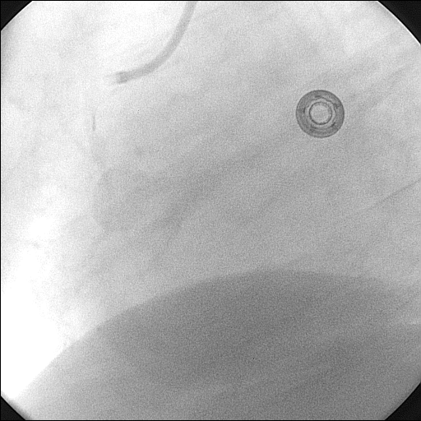
Blodprop i højre kranspulsåre

Slide 5
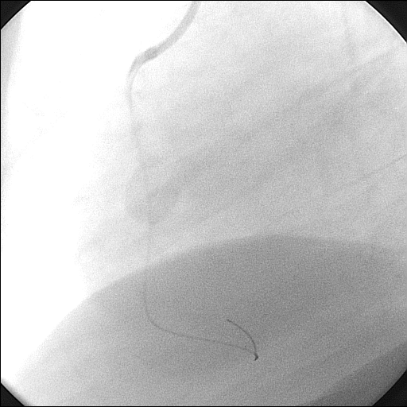
Efter ballon og stent

Slide 6
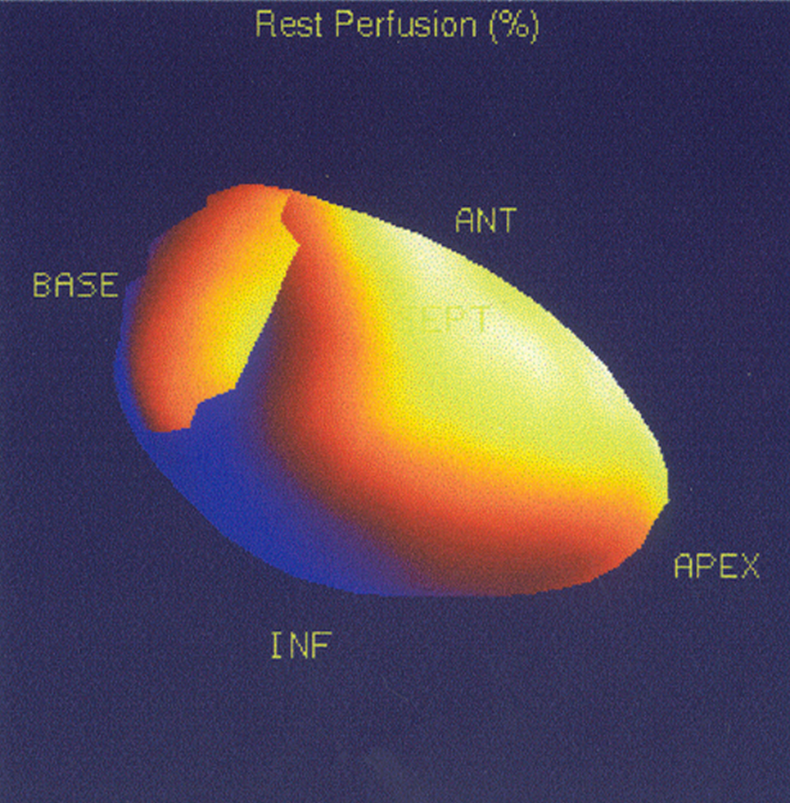

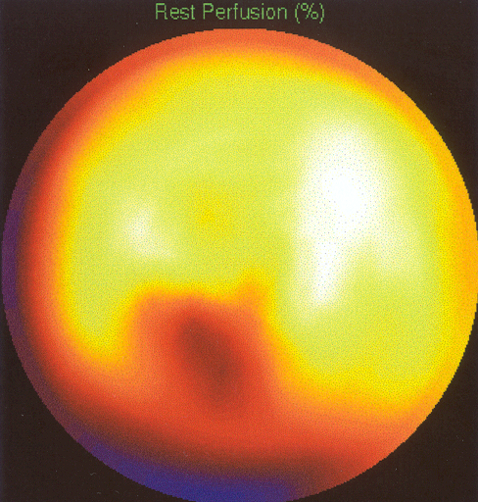
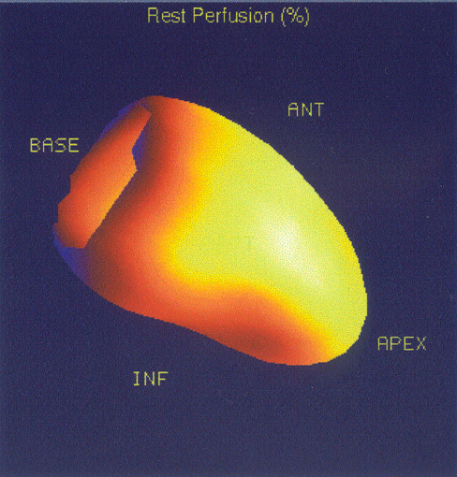
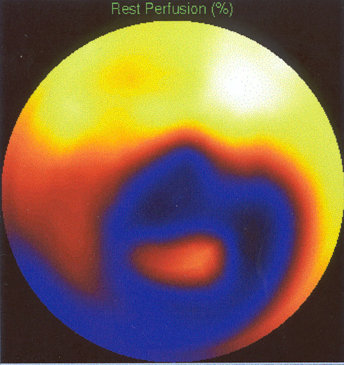
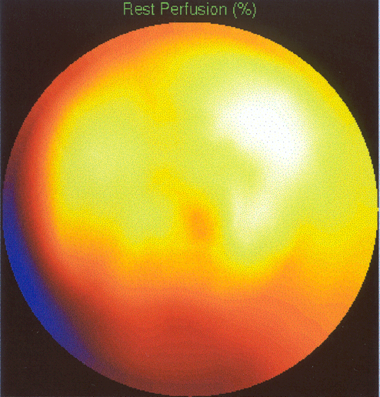
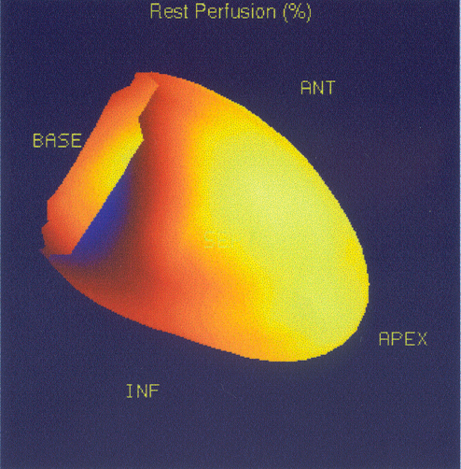
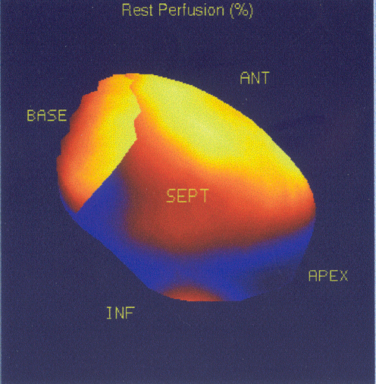
Variation af vævsskade
SPECT – Sestamibi – perfusion defects
4 STEMI patienter
Lukket højre kranspulsåre
Samme symptom varighed og vellykket behandling
Vellykket pPCI ➔ TIMI 3
40 %
10 %
Variation in endogent beskyttelsessystem?
50 %
5 %

Slide 7
Iskæmi-reperfusion skade
Ischemia
Reperfusion
Infarkt
størrelse
Celle
død
70%
Iskæmisk
prækonditionering
Reperfusion injury
40%
Iskæmisk skade
10%
Tid
Iskæmi
Reperfusion

Slide 8
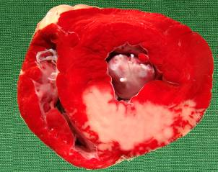
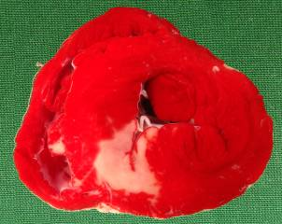
Spatiale and temporale
varianter af konditionering
Iskæmi
Reperfusion
Forudsigelig:
Iskæmi
Modificeret
reperfusion
Lokal og
fjern pre-C
Lokal post-C
Fjern-C
Uforudsigelig:
Iskæmi
Modificeret (gentle)
reperfusion
Iskæmi
Modificeret
reperfusion
Per-
Postkonditionering
Notes:
As for local ischemic conditioning, remote conditioning can be applied at different time points in relation to the index ischemia. This has clinical implications because preconditioning is applied prior to the index ischemia and therefore useful on predictable ischemia such as cardiac surgery. The challenge is higher in unpredcitable ischemia. In this situation local conditioning can only be applied as post conditioning during reperfusion after the index ischemia. However, remote conditioning can also be applied during and after the sustained index ischemia and both modalities have been used as I will show you shortly.

Slide 9
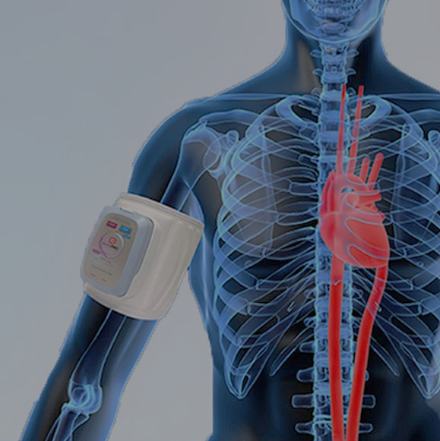
Fjernkonditionering
Remote ischemic conditioning (RIC)
Inflateres til 200 mm Hg

Slide 10

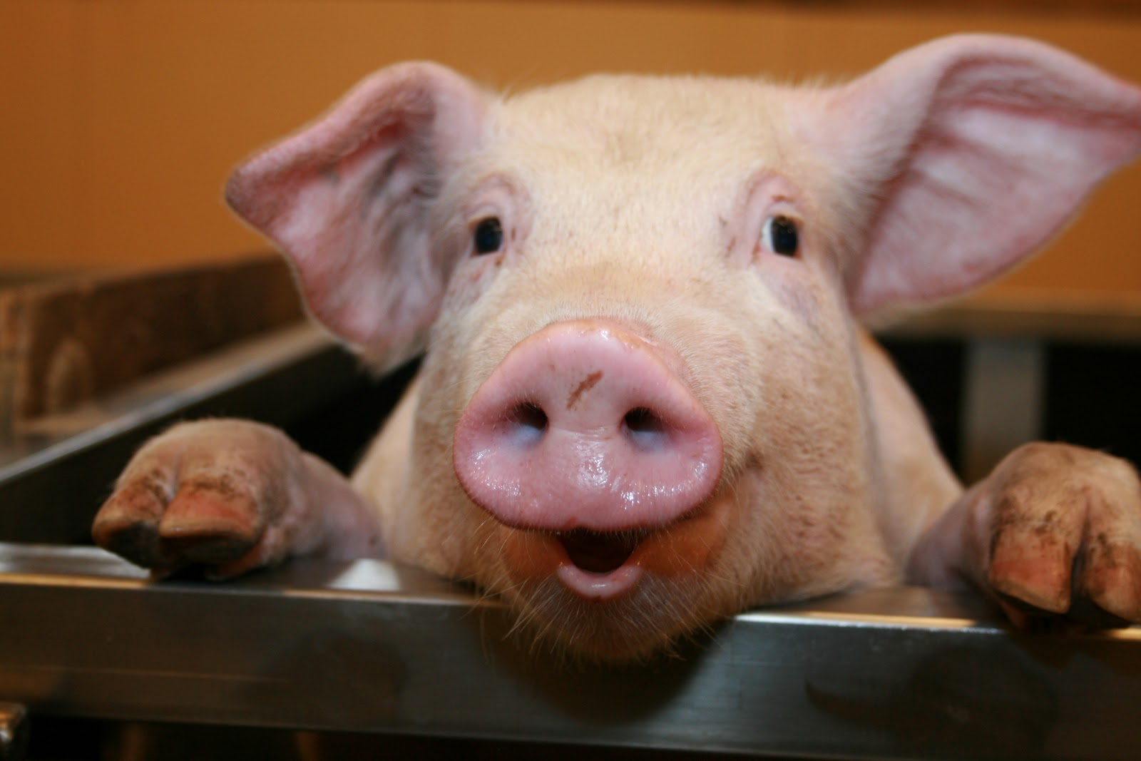
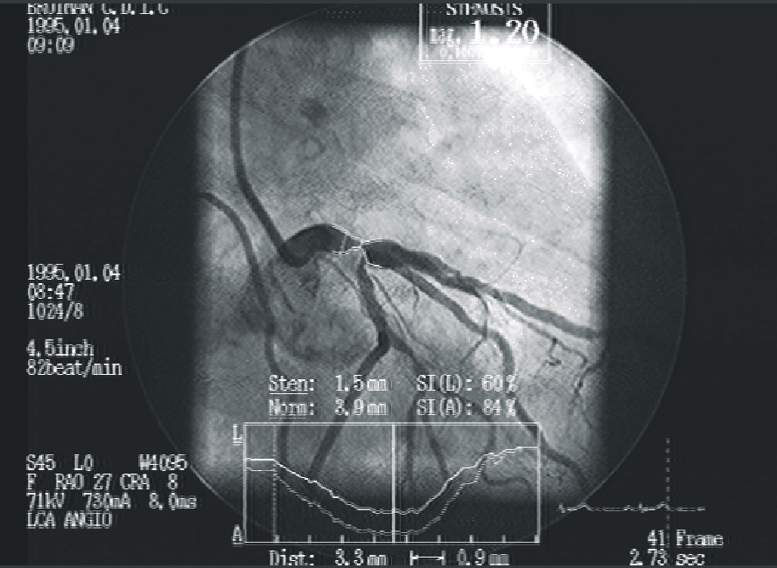
Fjernkonditionering - STEMI
Eksperimentel
Klinisk
Fjernkonditionering under ambulance transport hos patienter med STEMI før pPCI
Iskæmi
Reperfusion
190 min
34/35 d
p=0.033
0.75
0.55
Salvage Index (median [IQR])
PCI only rIPerC
Schmidt MR et al. Am J Physiol Heart Circ Physiol 2007;292:H1883-90.
Bøtker et al. Lancet 2010; 373: 727-34
Notes:
We have used remote ischemic perconditioning with the protective 4 times 5 minutes intermittent ischemia on the hind limg in a experimental pig model and demonstrated that this modality recudes myocardial infarct size by approximately 30%. In our randomized CONDI-trial we translated the concept to the clinical arena by demonstrating that remote conditioning during transportation to primary PCI can incease myocardial salvage index more than 30% in patients admitted for primary PCI for STEMI.

Slide 11
Betydning af infarkt lokalisering og åben/lukket koronar kar ved ankomst
Infarkt lokalisering
Åben/lukket kar
p=0.011
p=0.94
p=0.056
p=0.62
16
13
% of LV (median [IQR]
7
9
4
3
1
1
Lukket Åben
TIMI 0-1 TIMI 2-3
LAD Non-LAD
PCI alene RIC
Bøtker et al. Lancet 2010; 373: 727-34
Notes:
The highest benefit is achieved in the most seriously ill patients

Slide 12
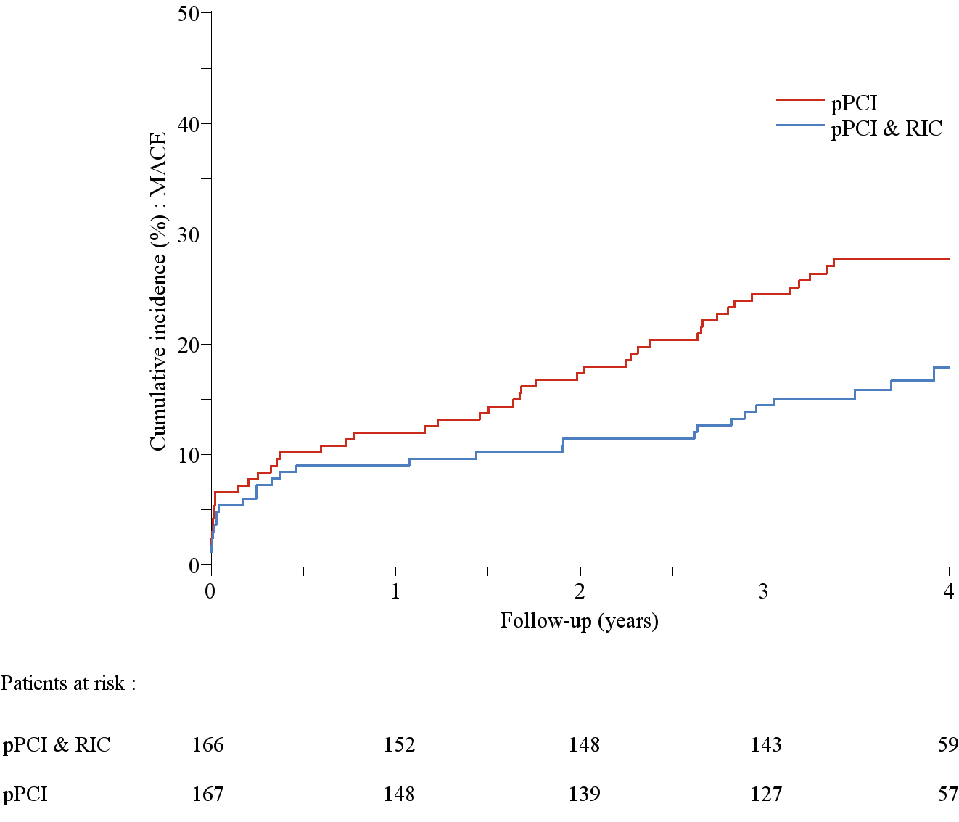
Translation til klinisk effekt
Kumulativ incidence af MACCE
p=0.034
Sloth et al. Eur Heart J. 2014;35:168-75
Notes:
Consequently, we were able to demonstrate that the reduction of infarct size could be translated into a clinical benefit in terms of major cardiovascular and cerbral events over a four year period following the index infarct.

Slide 13
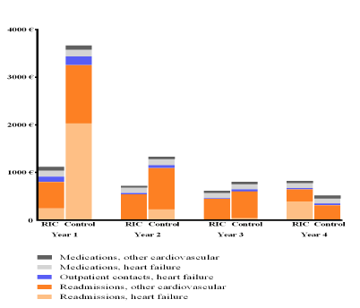
Kost-effektivitet
Sloth et al. Eur Heart J Acute Cardiovasc Care 2017
[Epub ahead of print]
Notes:
Most recently we calculated whether this could be translated into a cost-effectiveness benefit. As you can see on this slide, it was in fact the situation during the first two years following the infarction, while the benefit ceased thereafter. Most noteworthy is that the benefit is driven by a reduction for admission due to heart failure.

Slide 14
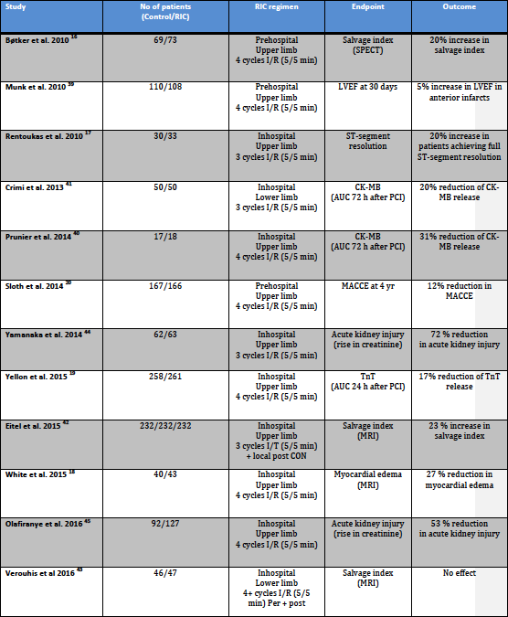
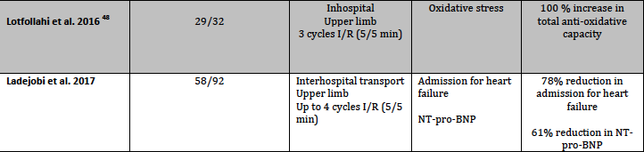
Effekt af RIC i studier
Schmidt, Rasmussen, Bøtker. J Cardiovasc Pharmacol Ther 2017, 22:302-309
Notes:
…. the findings may explain that this recent clinical Swedish study, which used extended numbers of RIC actually was the first neutral clinical study as no increased myocardial salvage after primary PCI was obtained by this approach while all other studies have shown beneficial effect using a variety of outcome measures.

Slide 15
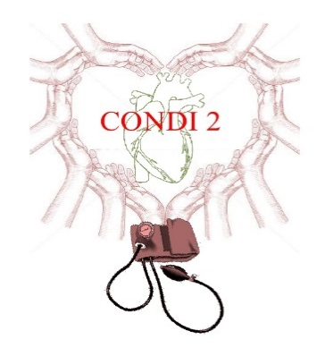
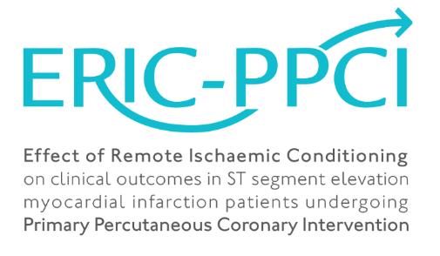
CONDI 2 – ERIC-PPCI studiet
Effect of Remote Ischaemic Conditioning
on clinical outcomes in ST-elevation myocardial infarction patients undergoing
Primary Percutaneous Coronary Intervention
5200 patienter med STEMI indlagt til pPCI i Danmark, Serbien, Spanien og UK
Randomiseret til +/- RIC i ambulancen (CONDI 2) eller ved hospitals indlæggelse (ERIC-PPCI)
Al anden behandling iht. standard procedurer
Primære EP: kombination af hjertedød og hospitalisering for hjertesvigt efter 1 år
>5000 inkluderet
Eur Heart J. 2015;36:1846-8.

Slide 16
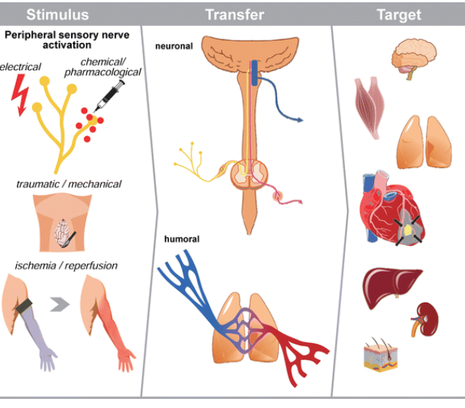
RIC: mekanismer
Notes:
Going to the transfer system I will focus on the circulating humoral mechanisms

Slide 17
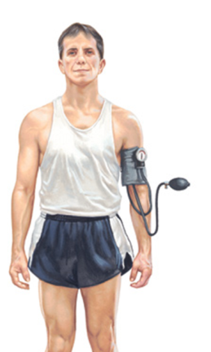
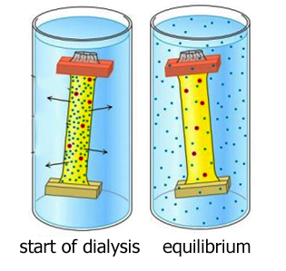
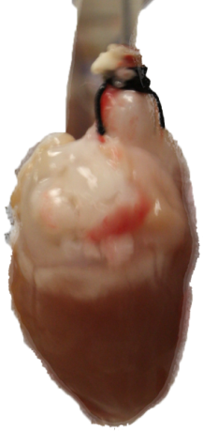


Dialysat som bioassay for RIC: Human til kanin overførsel
Shimizu et al. Clin Sci 2009;117:191-200
Michelsen et al. Basic Res Cardiol. 2012;107:260
Notes:
We and others have repeatedly shown that the circulating mediators are transferable from not only one experimental animal to another but also from one species to another. This allowed us to create a biological model for studying transfer mechanisms using dialysis and transfer from humans to a rabbit heart in a Langendorff model. We have compared the impact of RIC and exercise...

Slide 18
Medierende substanser: endogene opioider??
Human til kanin overførsel
Michelsen et al. Basic Res Cardiol. 2012;107:260
Michelsen et al. Submitted 2011
Notes:
We have also shown that the cardioprotective effect by both RIC and exercise can be attenuated by naloxone suggesting that the substances may involve opioids. However, as you can also see on the slide the attenuation was quite variable. This is a rather general experience when we study a single component of the signal and it may reflect that mediators are multiple.

Slide 19
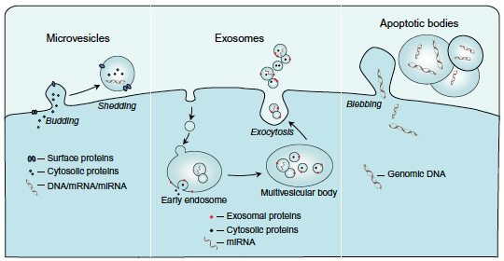
Interorgan kommunikation og overførsel
Exosomer, mikrovesikles og apoptotiske legemer er membran-bundne strukturerer, som secerneres af en række celle typer via specifikke mekanismer.
Deres indhold af forskellige komponenter omfatter proteiner, mRNA og microRNA, og gør EV ideelle formidlere af inter-organ kommunikation.
Diameter: 100-1000 nm 30–100 nm >1000 nm
Lawson et al. J Endocrinol 2016;228:R57-71
Notes:
These obervations stimulated to study the role of exosomes and microvesicles for mediating remote ischemic conditioning. Exosomes, microvesicles and apoptotic bodies are membrane-bound structures of different size that are secreted by a wide range of mammalian cell types via distinct mechanisms: Microvsicles bud, exosomes are released by exoxytosis and apoptotic bodies bleb. Their content of multiple compounds including proteins, microRNAs and even DNA, renders such vesicles ideal conveyors of inter-organ communication.

Slide 20
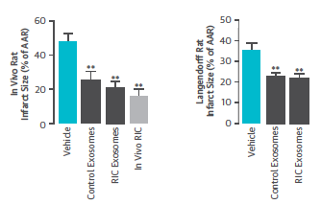
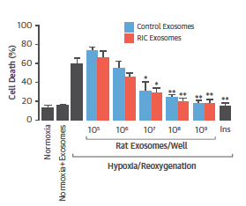
Exosom antallet beskytter
Vicencio et al. J Am Coll Cardiol 2015;65. 1525-36
Notes:
Vicencio and coworkers from Yellon’s group extended these findings to demonstrate that RIC apparently did not change the composition of the exosomes, so that it is not content but the rather the number of exosomes that confer cardioprotection as you can see on the right figure.

Slide 21
miRNA-144 stiger efter RIC hos patienter med stabil angina pectoris
Pryds et al. J Nucl Cardiol 2017 [Epub ahead of print]
Notes:
We recently studied the endogenous release of miRNA-144 as a biomarker of remote ischemic conditioning in patients with stable chronic heart failure and demonstrated a 40% increase. A little less than observed by Redington’s group.

Slide 22
Beskyttelsesmønstre
First Window eller tidlig beskyttelse
Potent kardioprotektion
Forbigående
Post-translational modifikationer
Second Window eller
forsinket beskyttelse
Mindre robust kardioprotektion
Længerevarende
De novo protein synthese
Infarkt reduktion
0
12
24
36
48
60
72
84
96
Tid efter konditionerings stimulus (timer)
Notes:
An interesting property of the conditioned stimulus is that it elicits a biphasic pattern of cardioprotection
On this graph
There is an initial phase, known as the first window or early preconditioning manifest almost immediately following the PC stimulus in which there is potent but transient cardioprotection, lasting for only 2-4 operating primarily via post-translational modification of existing proteins within the cell.
Roughly 12 hours after the initial stimulus, there is a resurgence of the protection known as the second window or delayed phase, which while it doesn’t possess the same magnitiude of protection as the first window, it exists for a much longer duration, and unlike the first window, relies on the synthesis of new proteins.

Slide 23
Phases of Protection: Beyond IR Protection?
First Window eller tidlig beskyttelse
Potent kardioprotektion
Forbigående
Post-translational modifikationer
Second Window eller
forsinket beskyttelse
Mindre robust kardioprotektion
Længerevarende
De novo protein synthese
Infarkt reduktion
Kronisk RIC? Neutrophil/monocyte/inflammation
0
12
24
36
48
60
72
84
96
Tid efter konditionerings stimulus (timer
Notes:
An interesting property of the conditioned stimulus is that it elicits a biphasic pattern of cardioprotection
On this graph
There is an initial phase, known as the first window or early preconditioning manifest almost immediately following the PC stimulus in which there is potent but transient cardioprotection, lasting for only 2-4 operating primarily via post-translational modification of existing proteins within the cell.
Roughly 12 hours after the initial stimulus, there is a resurgence of the protection known as the second window or delayed phase, which while it doesn’t possess the same magnitiude of protection as the first window, it exists for a much longer duration, and unlike the first window, relies on the synthesis of new proteins.

Slide 24
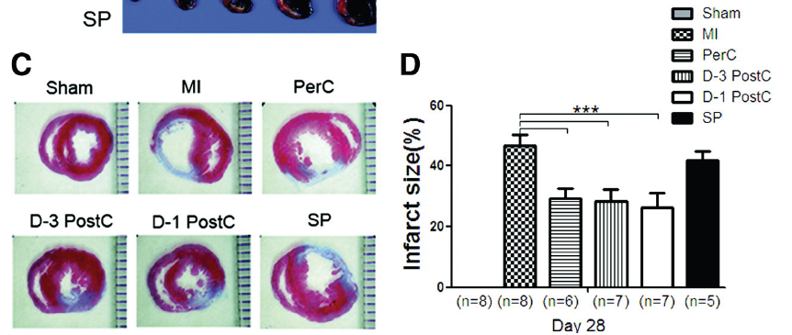
Effekt af forlængede konditionerings perioder
Repeated rIPostC improves survival in a rat model of myocardial infarction despite absence of further reduction of infarct size compared to rIPerC alone
Wei et al. Circ Res. 2011;108:1220-5.
Notes:
A potential solution may be a combination of remote per- and remote postcondtioning, which improved mortality independently of further infarct size reduction in a rat model.

Slide 25
CONDI-HF
Effekt af RIC ved kronisk hjertesvigt
28 days of daily RIC
 | Baseline | Follow-up | CI | p-value
Patients with CHF (n=22)
LV ejection fraction (%) | 44 ± 9.7 | 44 ± 9.2 | -0.89 to 0.55 | p=0.63
LV end-diastolic volume (ml) | 223 ± 61.1 | 220 ± 63.4 | -10.01 to 4.09 | p=0.39
Stroke volume (ml) | 94 ± 22.8 | 93 ± 21.7 | -5.39 to 1.96 | p=0.34
GLS - strain rate (%) | -8.9 ± 2.2 | -9.5 ± 2.5 | -1.18 to 0.13 | p=0.11
Systolic blood pressure (mmHg) | 130 ± 14.2 | 124 ± 16.8 | -10.03 to -2.67 | p=0.0018
Control subjects (n=21)
LV ejection fraction (%) | 71 ± 5.2 | 71 ± 5.3 | -0.15 to 0.44 | p=0.32
LV end-diastolic volume (ml) | 148 ± 32.9 | 147± 32.9 | -3.40 to 1.59 | p=0.46
Stroke volume (ml) | 104 ± 23.3 | 104 ± 24.0 | -2.00 to 1.39 | p=0.71
GLS - strain rate (%) | -14.1 ± 1.5 | -14.6 ± 1.4 | -1.07 to 0.24 | p=0.20
Systolic blood pressure (mmHg) | 145 ± 15.2 | 140 ± 13.7 | -9.30 to 0.73 | p=0.09
No effect of RIC on LV-EF (primary endpoint) Blood pressure reduced
Pryds et al. Basic Res Cardiol. 2017;112:67
Notes:
The VEGF related findings may be of some interest because it adds a potential for chronic RIC as has previously been proposed in experimental models.
We studied this in a clinical study, the CONDI-HF study, of 22 heart failure patients of ischemic origin. We compared the effect of RIC on a daily basis for four weeks and since we were unable to recruit a sufficient number for a heart failure control group, we compared the effects before and after 4 weeks treatment and related it to the response in 21 matched healthy controls. Primary end point was change in LV EF and as you can see on this slide, we did not find any significant difference in this variable or in other hemodynamic variables except systolic blood pressure that was reduced in the patient group and bordeline significantly in the control group.

Slide 26
Arbejdskapacitet og muskelstyrke
 |  | BASELINE | Follow-up | CI | P-value
Patients with CIHF
Peak cardiopulmonary exercise capacity:
- Workload (W/kg) |  | 1.6 ± 0.31 | 1.6 ± 0.33 | -0.02 to 0.08 | p=0.26
- Oxygen uptake (ml/kg/min) |  | 19.9 | 20.1 |  | p=0.59
Leg Extensor Power Rig (W/kg) |  | 2.3 ± 0.8 | 2.5 ± 0.8 | 0.02 to 0.21 | p=0.02
Control subjects
Peak cardiopulmonary exercise capacity:
- Workload (W/kg) |  | 2.3 ± 0.5 | 2.2 ± 0.5 | - 0.07 to 0.04 | p=0.61
- Oxygen uptake (ml/kg/min) |  | 28.2 ± 5.8 | 27.1 ± 5.4 | -2.34 to 0.22 | P=0.10
Leg Extensor Power Rig (W/kg) |  | 2.4 ± 0.8 | 2.6 ± 0.8 | 0.04 to 0.38 | p=0.02
No effect on CPX
Skeletal muscle strength increased
Pryds et al. Basic Res Cardiol. 2017;112:67
Notes:
Also we did not find any difference in exercise capacity measured as workload or oxygen uptake in either group. However, skeletal muscle strength improved in both groups.

Slide 27
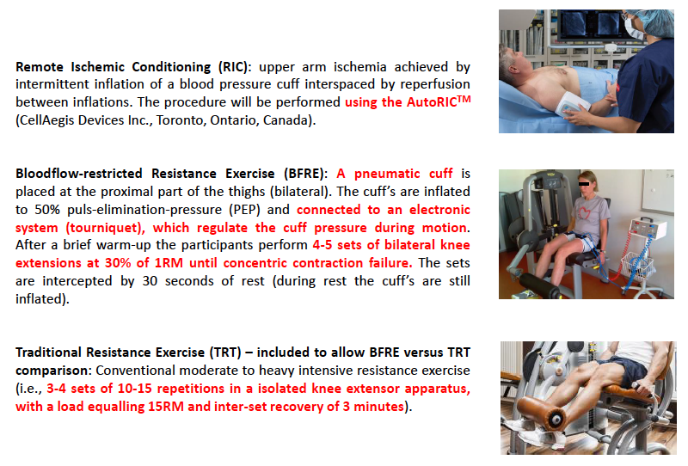
Humane eksperimentelle modeller

Slide 28
Effekt af træning og BFRE på mitokondriel respiration

Slide 29
Konklusion
RIC yder hjertebeskyttelse – den kliniske betydning afventer afklaring
Den potentielle effekt er størst hos højrisiko patienter
  Store forvægsinfarkter, kardiogent shock, hjertestop
Potentiale for kronisk anvendelse?
Notes:
So at this point I think it is fair to conclude:
Results of ongoing large scale trials needed to determine the clinical impact of RIC
Non-anesthetic coronary and vascular interventions hold the largest clinical potential
RIC may be translated into a clinical context of large anterior STEMI treated by pPCI and thrombolysis with short and long term clinical benefit
RIC in heart surgery apparently does not add further cardioprotection to current best pre-, per- and postoperative - predominantly propofol anesthesia

Slide 30

Mekanismerne bag konditionering er fortsat fragmentarisk
Skønne er de ting vi ser
Skønnere er de ting vi forstår
Men langt de skønneste er tilvisse de ting vi ikke forstår
Nicolaus Steno
(1638-86)
Danish anatomist, geologist and bishop
Notes:
Still, our insight in the mechanisms underling remote ischemic conditioning is fragmented, so to keep up the good mood, I think it is appropriate to quote the Danish anatomist, geologist and finally bishop Niels Steensen or Nicolaus Steno:
Beautiful are the things we see
More beautiful are the things we understand
Most beautiful, however, are the things that we do not understand
So, there is every reason to continue research within this important field.

Slide 31
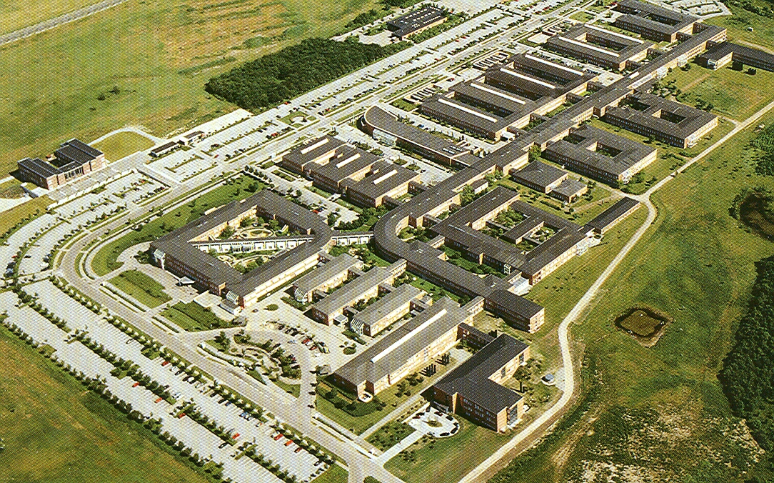
Tak!
Torsten Toftegaard Nielsen
Steen Buus Kristiansen
Michael Rahbek Schmidt
Morten Bøttcher
Christian J. Terkelsen
Keld E. Sørensen
Niels Holmark Andersen
Steen H. Poulsen
Henrik Wiggers
Leif Thuesen
Lars Krusell
Jens Flensted Lassen
Steen Dalby Kristensen
Evald Høj Christiansen
Henning Rud Andersen
Anne Kaltoft
Søren Nielsen
Michael Rehling
Raj Kharbanda
Thomas Engstrøm
Andrew Reddington
Troels Martin Hansen
Sven Trautner
Jan Møller Nielsen
Bo Løfgren
Nicolaj Støttrup
Kim Munk
Marie Mide Michelsen
Christian Møller Pedersen
Rebekka Thomsen
Jonas Riber Poulsen
Runa Poulsen
Jacob Johnsen
Astrid Drivsholm Sloth
Kasper Pryds
Marie Hjortbak
Thomas Ravn Lassen
Bent Roni Nielsen
Aarhus

